Slide 1
AWS Network Firewall
IPND

Slide 2
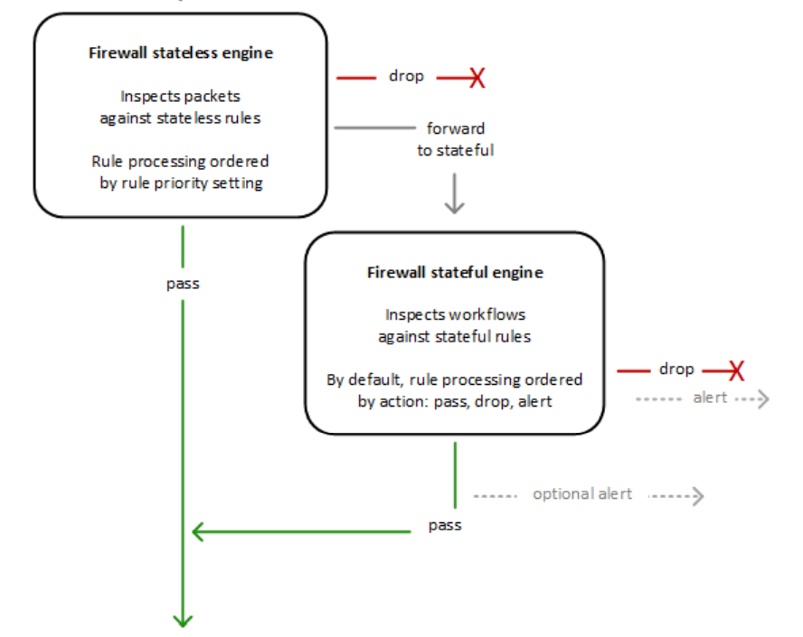
Network Firewall stateless and stateful rules engines
AWS Network Firewall uses two rules engines to inspect packets. The engines inspect packets according to the rules that you provide in your firewall policy.
The following figure shows the processing flow for packets coming through the firewall.
First the stateless engine inspects the packet against the configured stateless rules.
Depending on the packet settings, the stateless inspection criteria, and the firewall policy settings, the stateless engine might drop a packet, pass it through to its destination, or forward it to the stateful rules engine.
The stateful engine inspects packets in the context of their traffic flow, using the configured stateful rules. The stateful engine either drops packets or passes them to their destination. Stateful engine activities send flow and alert logs to the firewall's logs, if logging is configured. The stateful engine sends alerts for dropped packets and can optionally send them for passed packets.

Slide 3
Network Firewall stateless rules engines
Stateless rules engine
Inspects each packet in isolation, without regard to factors such as the direction of traffic, or whether the packet is part of an existing, approved connection. This engine prioritizes the speed of evaluation. It takes rules with standard 5-tuple connection criteria. The engine processes your rules in the order that you prioritize them and stops processing when it finds a match.
Network Firewall stateless rules are similar in behaviour and use to Amazon VPC network access control lists (ACLs).
Default stateless rule actions
If a packet doesn't match any stateless rule, Network Firewall performs the firewall policy's default stateless rule action for full packet or UDP packet fragment, depending on the packet type. Network Firewall only applies the fragment action setting to UDP packet fragments, and silently drops packet fragments for other protocols. The options for these actions settings are the same as for stateless rules.

Slide 4
Network Firewall stateful rules engines
Stateful rules engine
Inspects packets in the context of their traffic flow, allows you to use more complex rules, and allows you to log network traffic and to log Network Firewall firewall alerts on traffic.
Stateful rules consider traffic direction. The stateful rules engine might delay packet delivery in order to group packets for inspection.
By default, the stateful rules engine processes your rules in the order of their action setting, with pass rules processed first, then drop, then alert.
The engine stops processing when it finds a match. The stateful engine takes rules that are compatible with Suricata, an open source intrusion prevention system (IPS). Suricata provides a standard rule-based language for stateful network traffic inspection.
Network Firewall stateful rules are similar in behavior and use to Amazon VPC security groups. By default, the stateful rules engine allows traffic to pass, while the security groups default is to deny traffic

Slide 5
Route table configurations for AWS Network Firewall
To include the firewall in your Amazon Virtual Private Cloud VPC, you modify the VPC route tables so that the traffic that you want the firewall to filter passes through the firewall endpoints.
For example, to filter all traffic between an internet gateway and your customer subnets, you redirect incoming traffic from the internet gateway and outgoing traffic from the customer subnets through the firewall endpoint.

Slide 6
Routing
Internet gateway route table – Routes traffic that's destined for each customer subnet to the firewall subnet in the same Availability Zone.
Firewall subnet route tables – Route traffic that's destined for anywhere inside the VPC to the local address. Route traffic that's destined for anywhere else (0.0.0.0/0) to the internet gateway.
Customer subnet route tables – Route traffic that's destined for anywhere inside the VPC to the local address. Route traffic that's destined for anywhere else (0.0.0.0/0) to the firewall subnet in the same Availability Zone.

Slide 7







IPND Development AWS Network Firewall
Sydney Region
Destination | Target
10.10.10.0/24 10.10.20.0/24 10.10.30.0/24 | Firewall subnet Firewall subnet Firewall subnet
igw
Availability
Zone 1
Availability
Zone 2
VPC 10.10.0.0/16
Firewall subnet
10.10.0.0/24
Destination | Target
10.10.0.0/16 0.0.0.0/0 | local igw
VPN and Bastian subnet
10.10.10.0/24
nat-0db46ac32d6d83358
Destination | Target
10.10.0.0/16 0.0.0.0/0 | local Firewall subnet
Application subnet
10.10.20.0/24
Database subnet
10.10.30.0/24
Destination | Target
10.10.0.0/16 0.0.0.0/0 | local NAT Gateway

Slide 8
IPND Test AWS Network Firewall
Sydney Region
Destination | Target
10.11.10.0/24 10.11.20.0/24 10.11.30.0/24 | Firewall subnet Firewall subnet Firewall subnet
igw
Destination | Target
10.11.11.0/24 10.11.21.0/24 10.11.31.0/24 | Firewall subnet Firewall subnet Firewall subnet
Availability Zone1
Availability Zone 2
VPC 10.11.0.0/16
Firewall subnet
10.11.0.0/24
Destination | Target
10.11.0.0/16 0.0.0.0/0 | local igw
Firewall subnet
10.11.1.0/24
Destination | Target
10.11.0.0/16 0.0.0.0/0 | local igw
VPN and Bastian subnet
10.11.10.0/24
nat-0652e2c2de206b93d / ipndtst NAT Gateway - A
Destination | Target
10.11.0.0/16 0.0.0.0/0 | local Firewall subnet
VPN and Bastian subnet
10.11.11.0/24
nat-051906077d108bb31 / ipndtst NAT Gateway - B
Destination | Target
10.11.0.0/16 0.0.0.0/0 | local Firewall subnet
Application subnet
10.11.20.0/24
Database subnet
10.11.30.0/24
Destination | Target
10.11.0.0/16 0.0.0.0/0 | local NAT Gateway
Application subnet
10.11.21.0/24
Database subnet
10.11.31.0/24
Destination | Target
10.11.0.0/16 0.0.0.0/0 | local NAT Gateway

Slide 9
Step 1: Create rule groups

Slide 10
Step 2: Create Firewall Policy

Slide 11
Step 3: Create Firewall

Slide 12
Step 4: Update VPC Route Tables

Slide 13
Sydney Region
Destination | Target
10.10.X.0/24 | Firewall subnet
igw
Availability
Zone 1
Availability
Zone 2
VPC 10.10.0.0/16
Destination | Target
10.10.0.0/16 0.0.0.0/0 | local igw
Firewall subnet
10.10.0.0/24
Destination | Target
10.10.0.0/16 0.0.0.0/0 | local Firewall subnet
NAT subnet
10.10.X.0/24
Admin and Bastian subnet
10.10.10.0/24
Application subnet
10.10.20.0/24
Database subnet
10.10.30.0/24
Destination | Target
10.10.0.0/16 0.0.0.0/0 | local NAT subnet (currently NAT gateway)

